Slide 1
W11: Queue & Priority Queue
WIA1002/ WIB1002/WXES1117 :
Data Structures

Slide 2
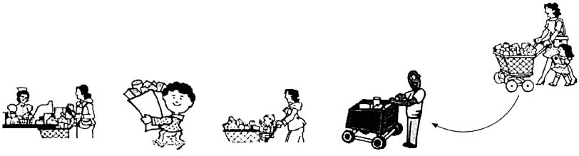
Queue
A waiting line at a grocery store or a bank is a model of a queue.
Which is first in this queue?
Which is last?
A B C D

Slide 3

Queues
A queue represents a waiting list. A queue can be viewed as a special type of list, where the elements are inserted into the end (back/tail) of the queue, and are accessed and deleted from the beginning (front/head) of the queue.
An item removed from the queue is the first element that was added into the queue. A queue has FIFO (first-in-first-out) ordering.

Slide 4
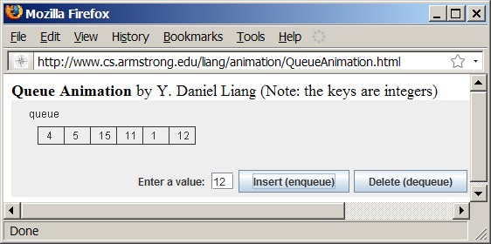
Queue Animation

Slide 5
Check Point
Where is element inserted and deleted from a queue?
What is this ordering called?

Slide 6
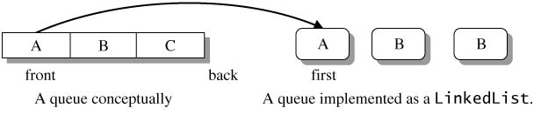
Implementing Queue
Using LinkedList to implement Queue
Since deletions are made at the beginning of the list, it is more efficient to implement a queue using a linked list than an array list.

Slide 7
Methods/Operations in Queue
enqueue() → en(in) / add
dequeue() → delete

Slide 8
MyQueue and Example
GenericQueue
TestQueue
Run

Slide 9
Check Point
Which type of data structure is best used to implement Queue?
What are the 2 important operations for Queue?

Slide 10
Exercise
Implement Queue using :
Arrays
ArrayList

Slide 11
Exercise
Study the codes at : http://www.beingjavaguys.com/2013/07/queue-implementation-in-java.html
Copy and rewrite the codes as generic QueueDemo <E> class
Write the pseudocode for the methods in the Queue using array

Slide 12
Exercise (Queue using array)
Write the codes for the following ArrayQueue<E>:
public ArrayQueue()
Public ArrayQueue(int initial)
public void enqueue(E e)
public E dequeue()
public E getElement()
public boolean isEmpty()
public int size()
public void resize()

Slide 13
Priority Queue
A regular queue is a first-in and first-out data structure. Elements are appended to the end of the queue and are removed from the beginning of the queue.
In a priority queue, elements are assigned with priorities. When accessing elements, the element with the highest priority is removed first.
A priority queue has a largest-in, first-out behavior. For example, the emergency room in a hospital assigns patients with priority numbers; the patient with the highest priority is treated first.

Slide 14
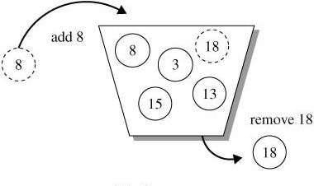
Priority Queue Collection
A priority queue is a collection in which all elements have a comparison (priority) ordering.
It provides only simple access and update operations where a deletion always removes the element of highest priority

Slide 15
The PriorityQueue Class
PriorityQueueDemo
Run

Slide 16
Example: MyPriorityQueue
MyPriorityQueue
TestPriorityQueue
Run

Slide 17
The Heap Class
Heap

